Slide 1
Fake News Detection: A deception detection technique using Machine Learning!
Pattern Recognition Course Project by Surya Sudharshan (UFID: 5019 -3163)

Slide 2

Introduction
What is Fake News?
Fake news is news, stories or hoaxes created to deliberately misinform or deceive readers.
What are the effects of Fake News?
There can be many effects of fake news targeted depending on the target
They can topple multinational companies
Get a political candidate elected or fired
Tarnish a famous person’s reputation

Slide 3
Challenges of Fake News and Machine Learning
The challenges of fake news and bias
Machine Learning based automation to detect fake news

Slide 4
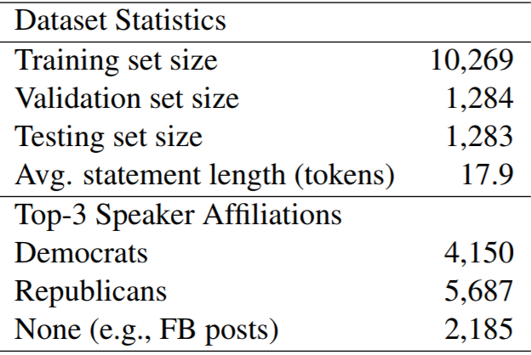
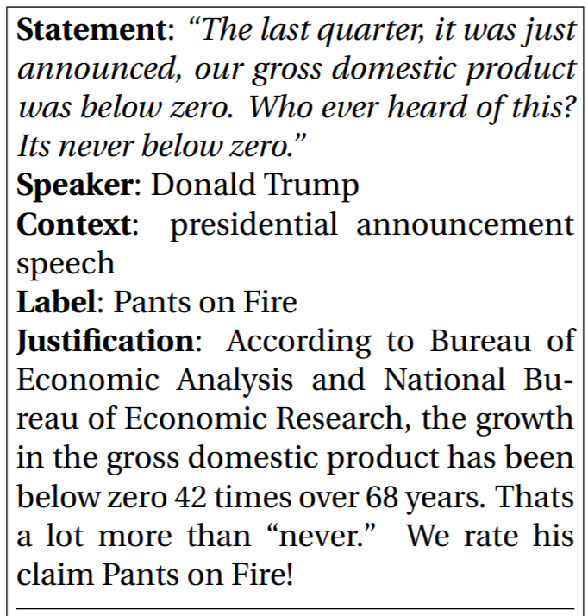
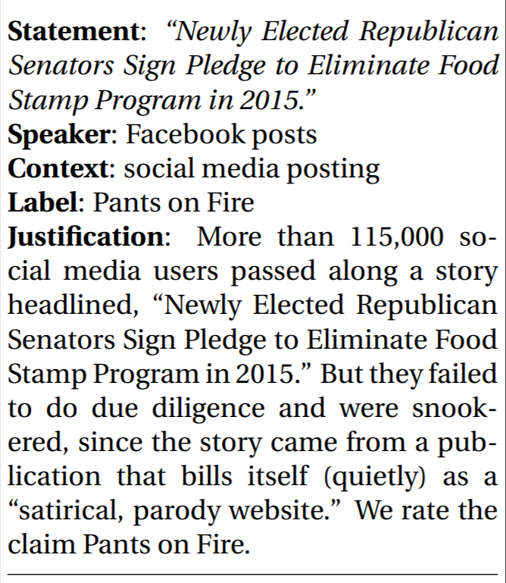
Dataset: LIAR dataset
Dataset collected by William Yang Wang, sourced from Politifact.com
Example 1 Example 2

Slide 5
Dataset Features
Post cleaning the data and checking for data balance
Feature 1
Feature 2
Bag of Words(BoW)
Each word is counted for frequency
Base line Features
Simple model, provides
Term Frequency – Inverse Document Frequency (TF – IDF)
Used to penalize commonly occurring words like “The”
Rare words that give context are given more weights

Slide 6
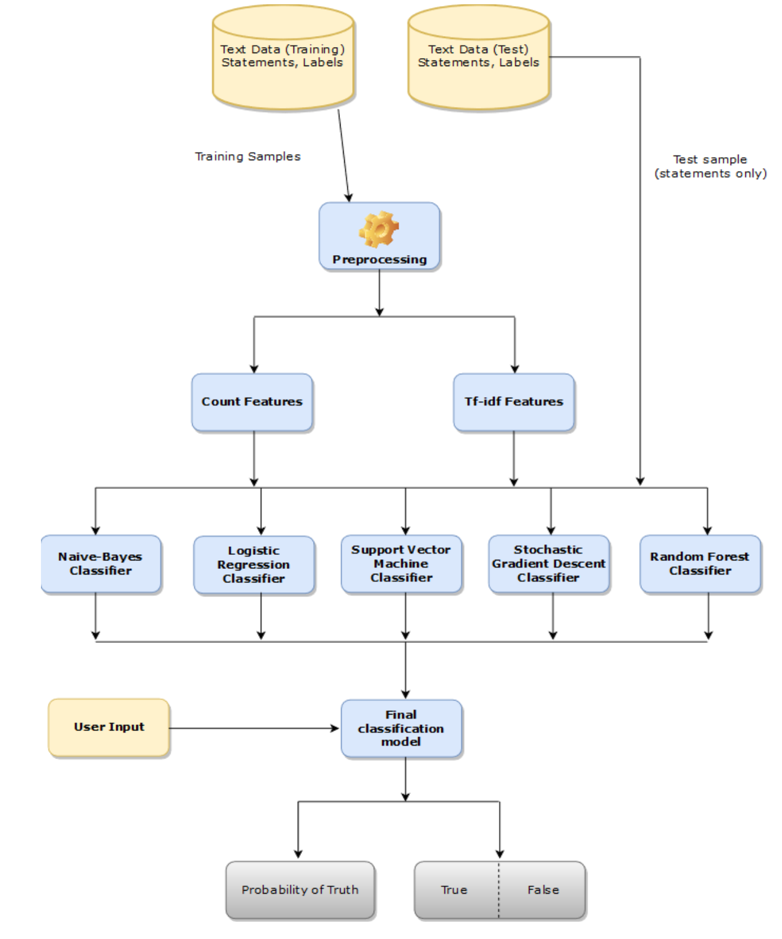
Architecture

Slide 7
Training
Training data is split into 80:20
First iteration has BoW feature, models evaluated based on just this feature
Second iteration has TF – IDF feature, models evaluated and 2 candidate models are chosen for optimization
Final model is trained with selected parameters, which turns out to be Logistic Regression

Slide 8
Implementation
Python 3.X
Scikit-Learn
Pandas
NLTK
Numpy

Slide 9
Performance Evaluation
Confusion Matrix
F1- Scores
Feature utilization in each iteration
Multiple machine learning models
Best of all chose models

Slide 10
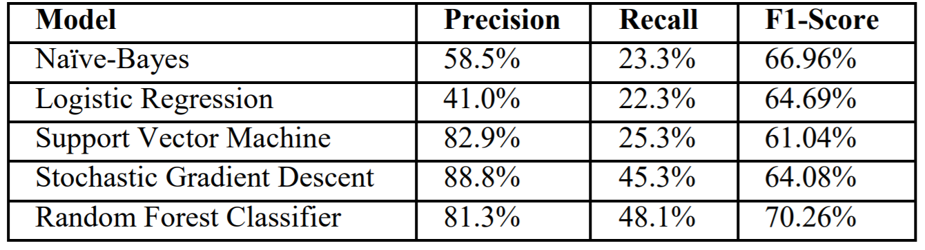
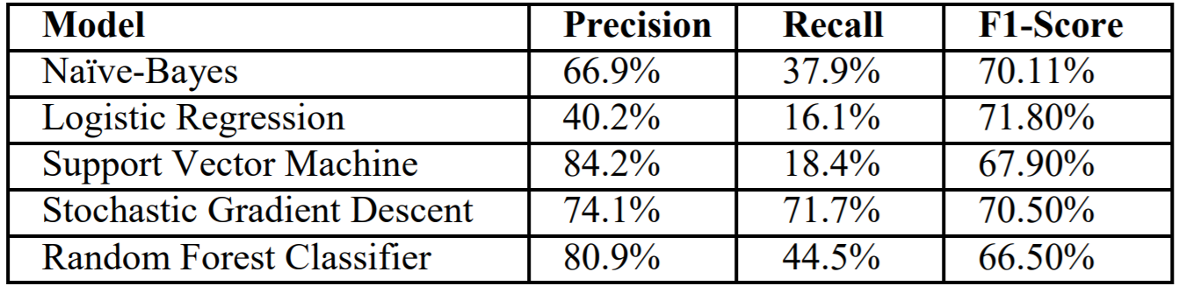
Results
First iteration results with BoW model
Second iteration results with TF-IDF model

